Slide 1


Python Programming Summer Camp
Class # 4
Lists: Collection of Items
By Asim Munawar

Slide 2




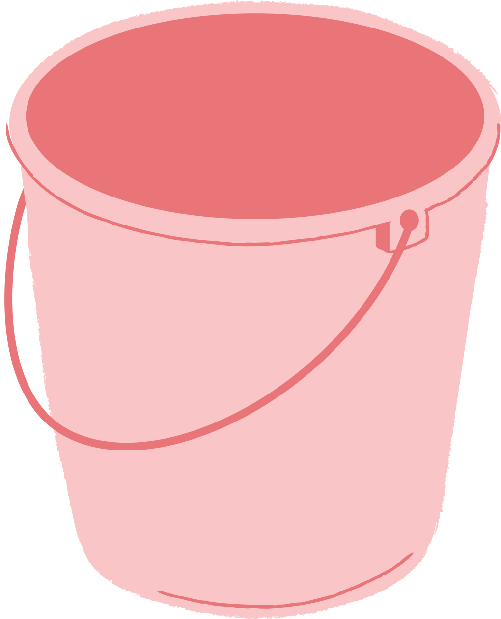
Variable is like a bucket
if/else help make decisions
9
“I live in bucket”
“9”
tempreture = 100
if tempreture > 90:
print(“It is very hot, stay inside!")
else:
print("Go out and enjoy")
my_fav_variable1

Slide 3
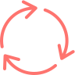

Loops help with Repeating Tasks
Get Input from User
for i in range(100):
print(i, “My Name is Asim”)
name = input("What is your name? ")
age = input("How old are you? ")
print("Hello" + name + "!")
print("You are", age, "years old.")

Slide 4
Types of Variables
int Integer (whole number) age = 10
float Decimal number price = 3.14
str String (text) name = "Ali"
bool Boolean (True/False) is_ready = True

Slide 5
Fun Exercise: Swapping Values
a = 20
b = 9
# Write a code to put the value of a in b, and the value of b in a

Slide 6


Course Plan
Lesson 1: Printing Fun – Say Hello to Python
Lesson 2: Variables – Remembering Things in Code
Lesson 2: If/Else – Making Decisions
Lesson 3: Loops – Doing Things Again and Again / Inputs
Lesson 5: Build a Mini Game – Guessing or Quiz
Lesson 4: Lists – Collecting Many Things
Lesson 6: Functions – Teach the Computer a New Trick
Lesson 7: Files – Saving and Reading Data
Lesson 8: Simple App with Gradio – Make Your Own Tool
Lesson 9: Final Project – Build and Present Your App

Slide 7

What is a List?
A list is like a backpack that can hold many things.
# List of favorite snacks
snacks = ["chips", "cookies", "apple", "candy"]
print(snacks)
# Output
['chips', 'cookies', 'apple', 'candy']
✅ [] square brackets
✅ Items are separated by commas
✅ You can store strings, numbers, or even mix types

Slide 8
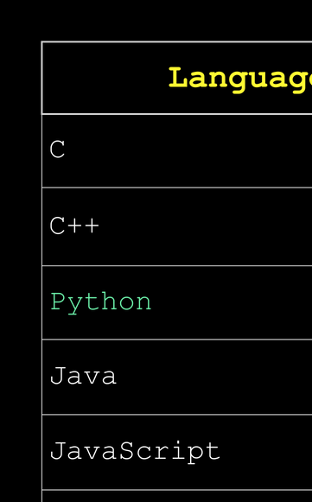

Slide 9

Access Items by Position
Each item has a number called an index (starts from 0)
snacks = ["chips", "cookies", "apple", "candy"]
print("First snack is:", snacks[0])
print("Last snack is:", snacks[3])
# Remember: Index starts at 0, not 1!
Try this:
print("Oops:", snacks[4]) #Why does this cause an error

Slide 10
How to Add Items in a List?
Ask the user to enter 5 numbers. Store them in a list. Then print whether each number is even or odd.
nums = []
for i in range(5):
n = int(input("Enter a number: "))
nums.append(n)
for num in nums:
if num % 2 == 0:
print(num, "is Even")
else:
print(num, "is Odd")

Slide 11

Software Bug Can be very Expensive
The “Mars Climate Orbiter” Crash (1999)
A $327 million NASA spacecraft crashed into Mars…
because one team used the wrong units in the program.
Be very careful what you write
Bugs don’t just crash programs, they can crash spacecraft 😆🚀🔥

Slide 12

numbers = [9, 2, 5, 8, 1]
print("Original list:", numbers)
# Sort the list
numbers.sort()
print("Sorted list:", numbers)
# Add a number
numbers.append(10)
print("After adding 10:", numbers)
# Length of the list
print("Total items:", len(numbers))
# Average of the list
avg = sum(numbers) / len(numbers)
print("Average:", avg)
# Maximum and Minimum
print("Max:", max(numbers))
print("Min:", min(numbers))
# Loop through and print each number
print("All numbers:")
for num in numbers:
print(num)
Magic of List

Slide 13
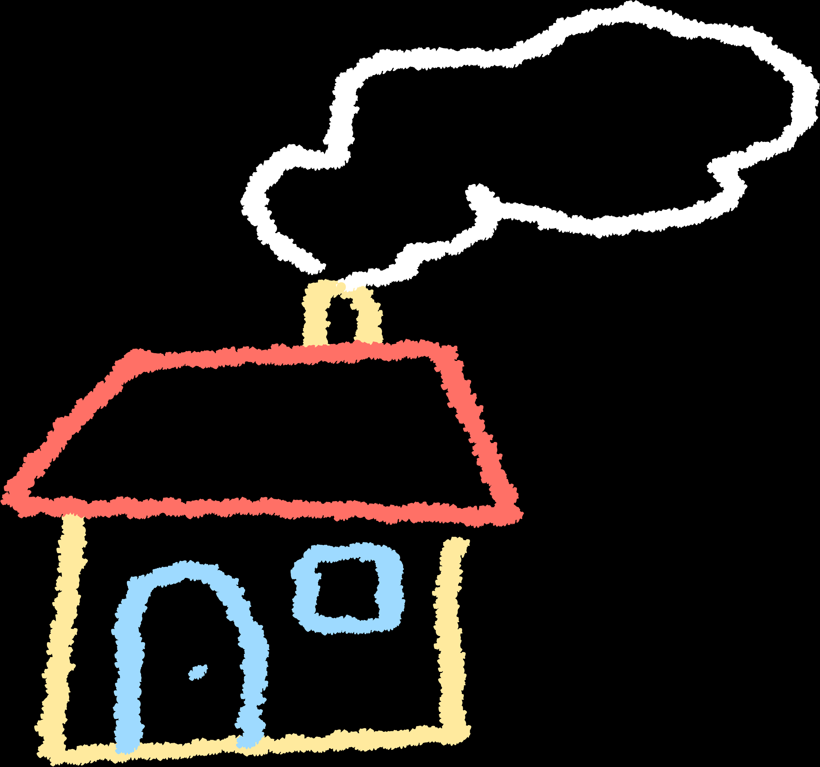
Homework
1. 📋 List Your Favorite Things
Ask the user to enter 3 of their favorite hobbies using input() and store them in a list. Then print each hobby using a for loop.
2. 🐾 Animal Guessing
Create a list of 5 animals. Ask the user to guess one. If it’s in the list, print “Yes, that’s in the list!” Otherwise, print “Nope, try again!”
3. 📈 Average Finder
Ask the user to input 4 numbers. Store them in a list, calculate the average, and print it. Use a for loop and a variable to compute the sum.
4. 🆚 Even or Odd
Create a list of 5 numbers using input(). Use a for loop to print whether each number is even or odd using if-else.
5. 🔤 Alphabetical Sorting
Create a list of 5 of your favorite fruits. Store them in a list and print the list sorted in alphabetical order.
🌟 Bonus Challenge: ✂️ Remove Items
Create a list with these items: ["apple", "banana", "grape", "orange", "banana"]
Ask the user for a fruit to remove. Remove the first occurrence of that fruit from the list and print the updated list.
(Hint: Use .remove())

Slide 14


Thank You

